Slide 1
CaPool
http://capool.azurewebsites.net/
Shared Travel, Simplified

Slide 2
Cloud Deployment
Microsoft Azure
http://capool.azurewebsites.net/

Slide 3
Interface
1. UI & UX
Colour Scheme Consistency
Contrast
Layout Common Conventions
2. Accessibility & Responsiveness

Slide 4
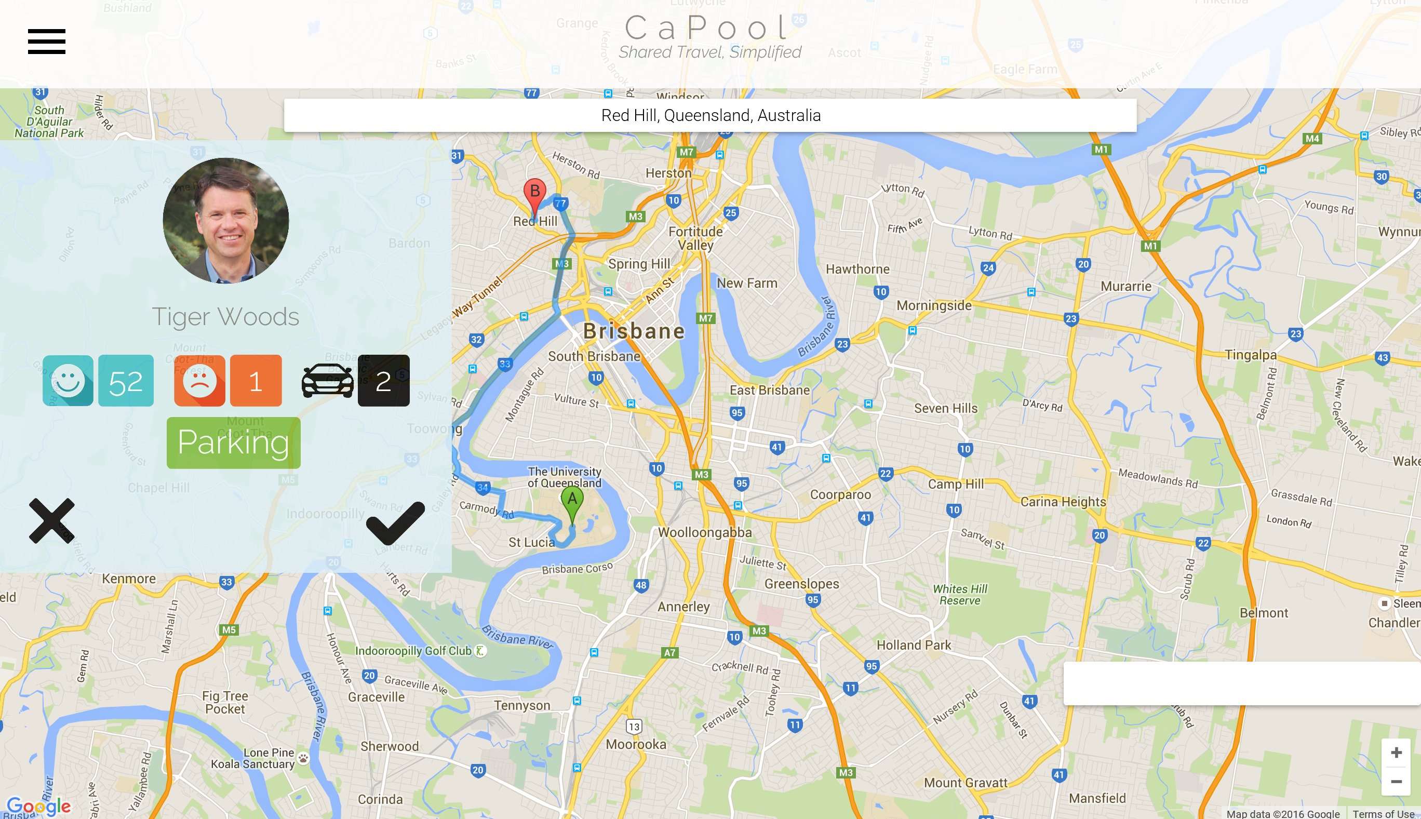
1. Layout Common Conventions
1.
2.
3.
4.
Menu
Heading Bar with Logo (homepage link)
Search Bar
Locate Me Button

Slide 5
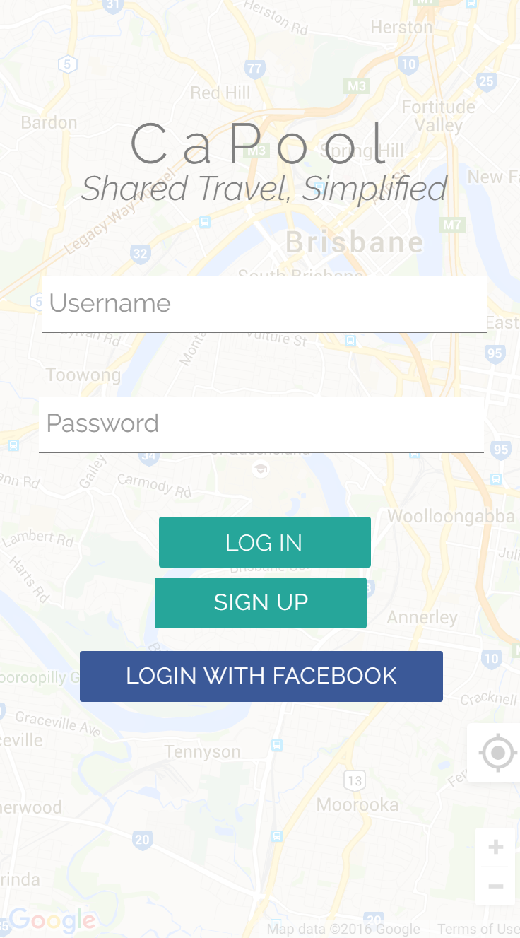
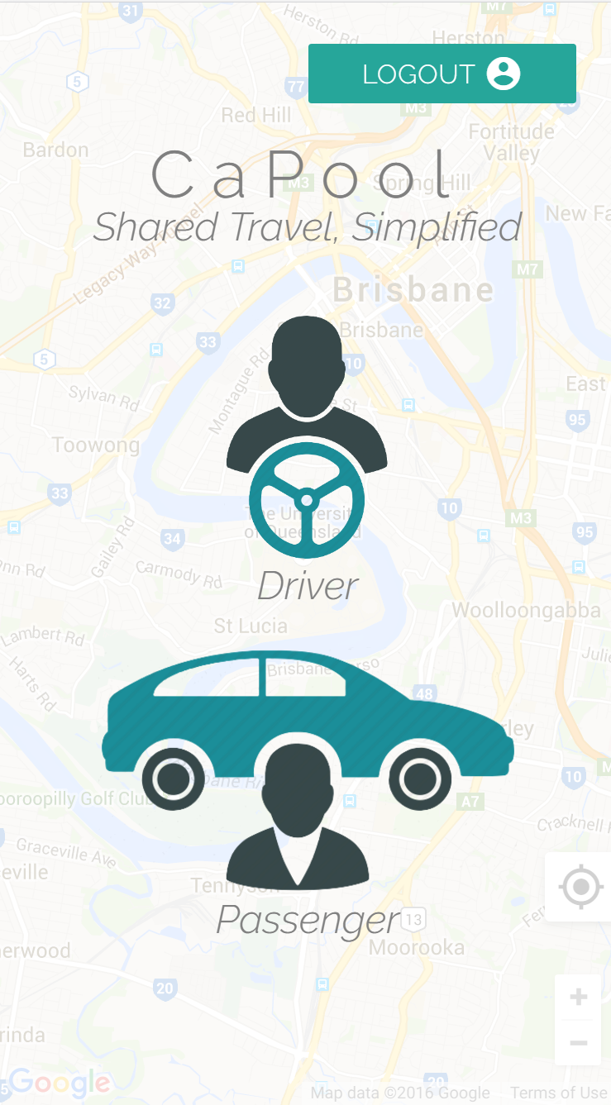

1. Colour Scheme Consistency
The website primarily uses a colour scheme consisting of five main colours:
Black
Grey
Blue
Teal
White

Slide 6
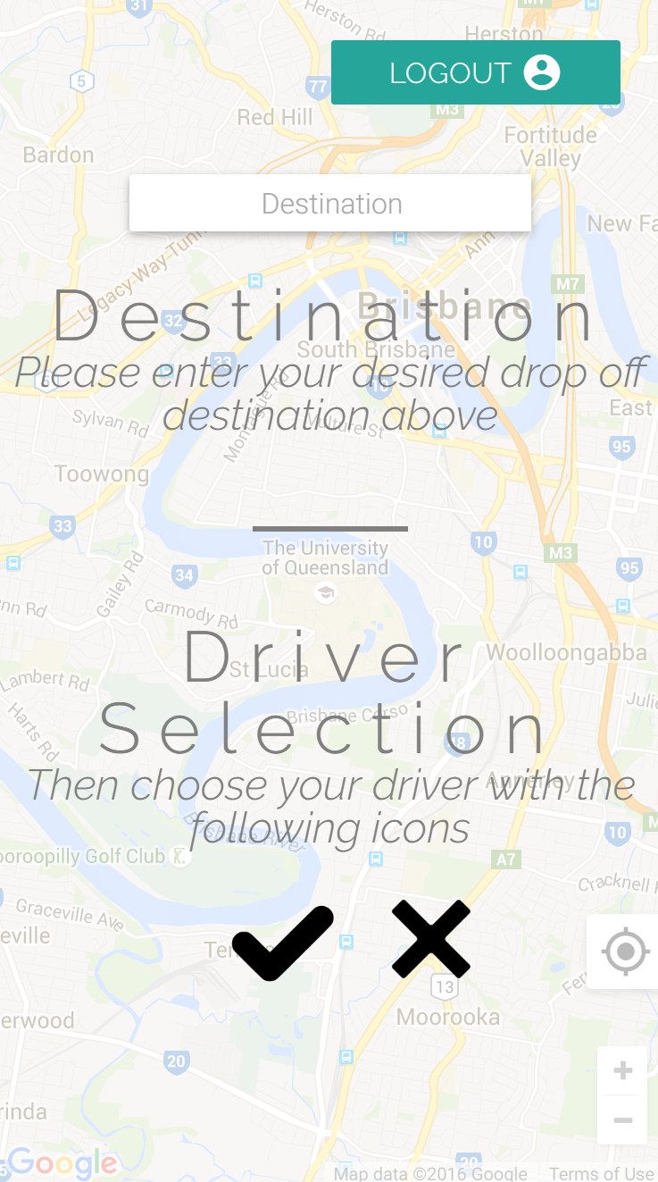
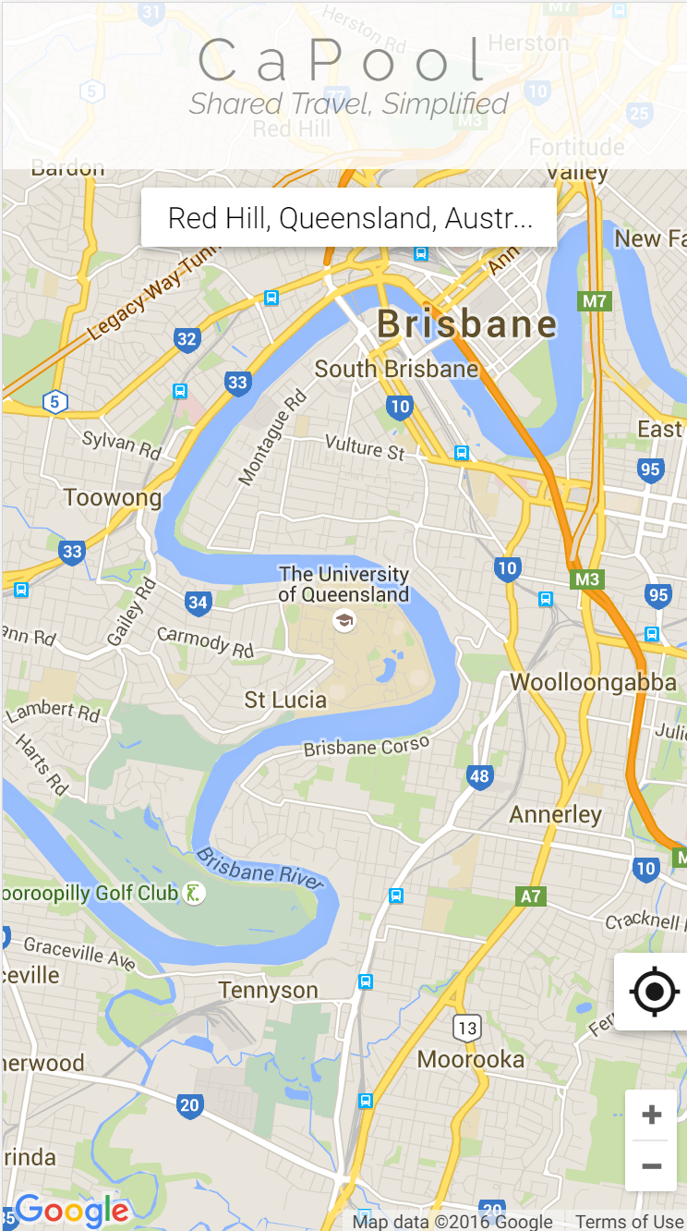
2. Responsiveness
iPhone 6:
375 x 667px (later doubled)

Slide 7
Functionality
Advanced JavaScript
Server Side Language
Database

Slide 8
1. Advanced JavaScript

Slide 9
2. Server Side Language

Slide 10
3. Database

Slide 11
Security
DoS Attacks
OWASP Top 10

Slide 12
1. What is a DoS?
DoS: Denial of Service Attack
It’s a malicious attempt to deny access for the legitimate users of a service
An attacker uses varying amounts of non-trivial computing resources to send excess traffic to a site
Causing the site to stop loading due to not being able to keep up with the number of concurrent (fake) users

Slide 13
1. DoS Attack Prevention
Azure has built-in load balancers that starve off DOS type Attacks
Including standard detection and mitigation techniques such as SYN cookies, rate limiting, and connection limits.
As the application is hosted in the cloud there is the advantage of auto-scaling when attacks occur, so the site is less likely to crash.

Slide 14
2. OWASP Top 10
Injection
Broken Authentication and Session Management
Cross-Site Scripting (XSS)
Insecure Direct Object References
Security Misconfigurations
Sensitive Data Exposure
Missing Function Level Access Control
Cross-Site Request Forgery (CSRF)
Using Components with Known Vulnerabilities
Unvalidated Redirects and Forwards

